Slide 1
Stock Market Forecasting
Using Long Short Term Memory (LSTM) Model

Slide 2
PROJECT -- P132 (Group 3)
Vishal Thakursing Chavan
Soham Shailendra Jondhale
Shaikh Faraaz Abdul Jabbar
BUY
SELL
Manikandan C
Hithindra.P
Charan Manohar Nandi
RAKESH N

Slide 3
Business Objective:
To build the stock price prediction model, we will collect dataset from valid resources (NSE, BSE, Yahoo Finance etc).
To develop the dashboard for stock analysis and forecasting to next 10 days stocks.

Slide 4
Milestones:
01
To collect the historical stock price data using yfinance
02
Cleaning the data.
03
Applying different machine learning models to verify their usefulness
04
Deployment using streamlit

Slide 5

DATASET
ITC (National stock exchange)
BUY?
45%
AND
SELL?
35%
Source:
25%
15%

Slide 6
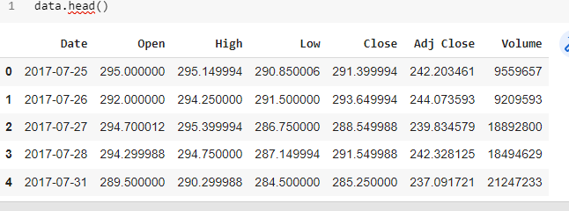

Slide 7
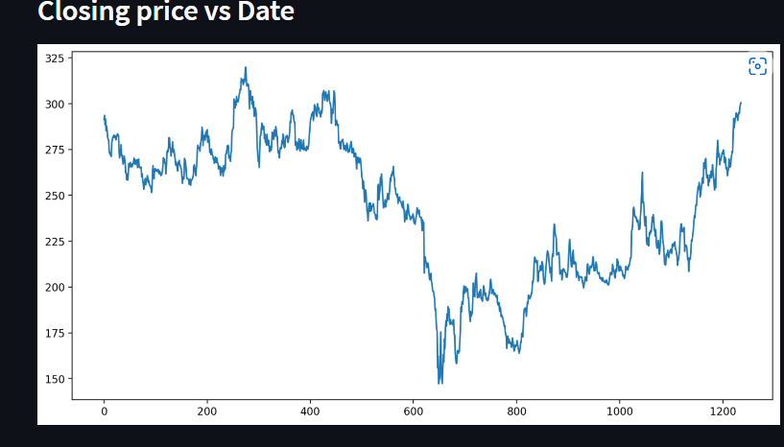

Slide 8
Programming language
Python
Visualization
Plotly
Matplotlib
BUY
Libraries
Pandas.
Numpy.
Scikit-Learn.
Math.
Tensorflow.
SELL

Slide 9


BUY
Integrated development environment (IDE)
SELL

Slide 10
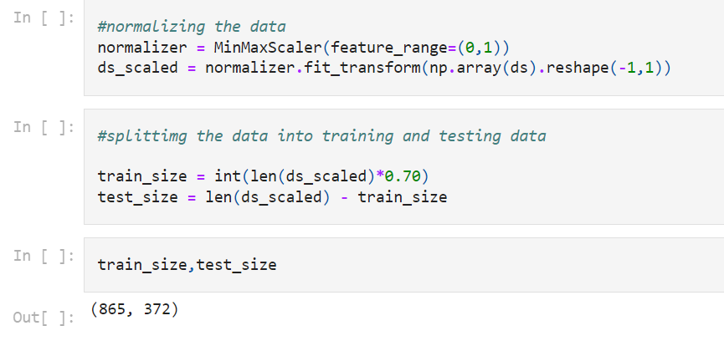
Normalizing & Splitting
Normalizing the Data using MinMaxScalar.
Splitting the Data into Testing and Training Data.

Slide 11
LSTM MODEL
LSTM stands for long short-term memory networks, used in the field of Deep Learning. It is a variety of recurrent neural networks (RNNs) that are capable of learning long-term dependencies, especially in sequence prediction problems. LSTM has feedback connections, i.e., it is capable of processing the entire sequence of data, apart from single data points such as images.

Slide 12
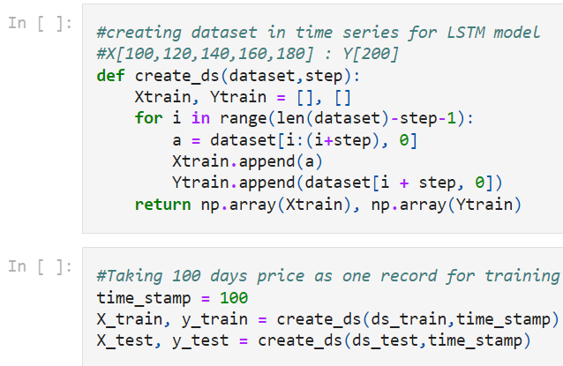
Building Model
Creating Datasets in time series for LSTM Model.
E.g.: X[100,120,140,160,180] : Y[200].
Creating LSTM Model using Keras.
Training Model with Adam Optimizer and
Mean Squared Error Loss Function

Slide 13
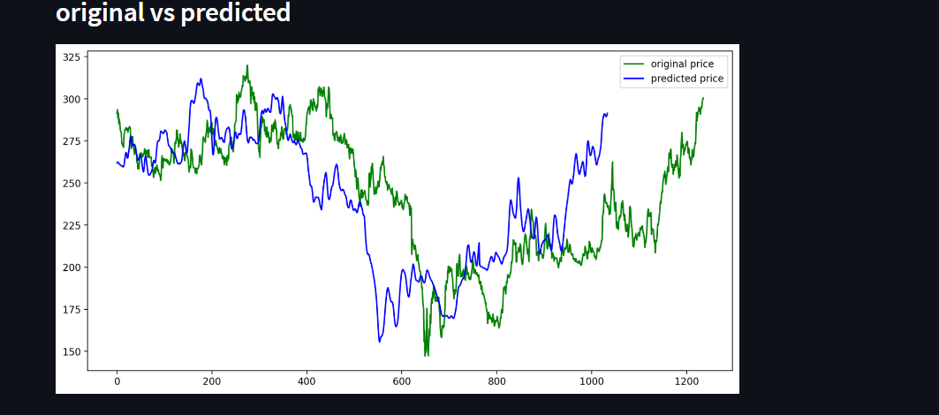

Slide 14
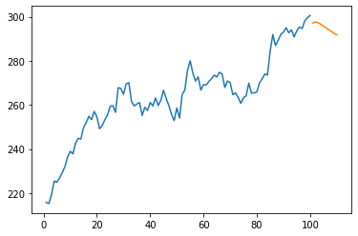
Plotting the Next 10 Days Predicted Price.

Slide 15

Web App Framework

Slide 16
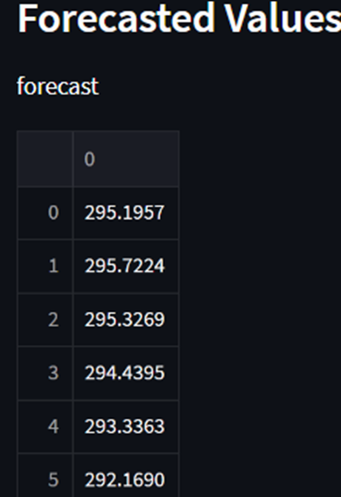
Conclusion:
BUY
SELL

Slide 17
GitHub Links:
https://github.com/vishalchavan5/stock-market-forecasting
https://github.com/sohamjondhale/Stock-Market-Prediction-by-LSTM-Model
https://github.com/Mani512996/Data-Science-project.git
https://github.com/charannandi2508/Project-.git
https://github.com/hithindra/Projects-Data-Science-.git
https://github.com/Rakeshprojec/my-project
https://github.com/mrfaraaz/Stockmarket-Prediction-By-LSTM

Slide 18

Thank You
ExcelR & AI Variant team.

